Slide 1
Computing Fundamentals

Slide 2
Importance of Computer
Computers are an important part of our lives.
For example:
They are used for the reservation of tickets for airplanes and railway, payment of
telephone and electricity bills, deposit and withdrawal of money from banks,
processing of business data, forecasting of weather conditions, diagnosis of
diseases, searching for information on the internet, etc.
Fall 2021

Slide 3
What is a computer???
A computer is a fast electronic device that processes the input data according to the instructions given by the programmer/user and provides the desired information as output.

Slide 4
CHARACTERISTICS OF COMPUTER
Speed: The computer can process data fast, million of instructions per second. Some calculations that would have taken hours and days to complete otherwise, can be completed in a few seconds using the computer.
Accuracy: Computers provide a high degree of accuracy.
Diligence: When used for a longer period of time, the computer does not get tired or fatigued. It can perform long and complex calculations with the same speed and accuracy from the start till the end.

Slide 5
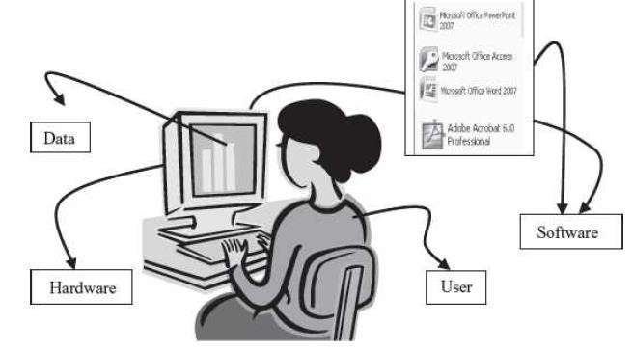
COMPUTER SYSTEM
The Computer Consists of four parts.
Hardware
Software
Data
User

Slide 6
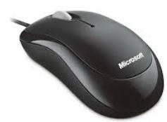
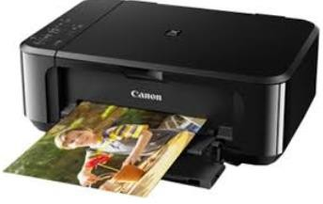
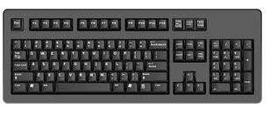
Hardware
Hardware consists of the mechanical parts that make the computer as a machine. The
hardware consists of physical devices of the computer. The devices are required
for input, output, storage and processing of the data. Keyboard, monitor, hard disk
drive, floppy disk drive, printer, processor and motherboard are some
of the hardware devices.

Slide 7
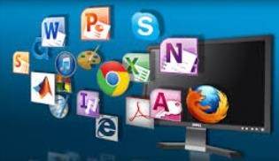
Software
Software is a set of instructions that tells the computer about
the tasks to be performed and how these tasks are to be
performed.
Program is a set of instructions, written in a language understood by the computer, to perform a specific task. A set of programs and documents are collectively called software.

Slide 8
DATA & INFORMATION
Data:
Data is the collection of facts and figures.
Information:
Processed form of data.

Slide 9
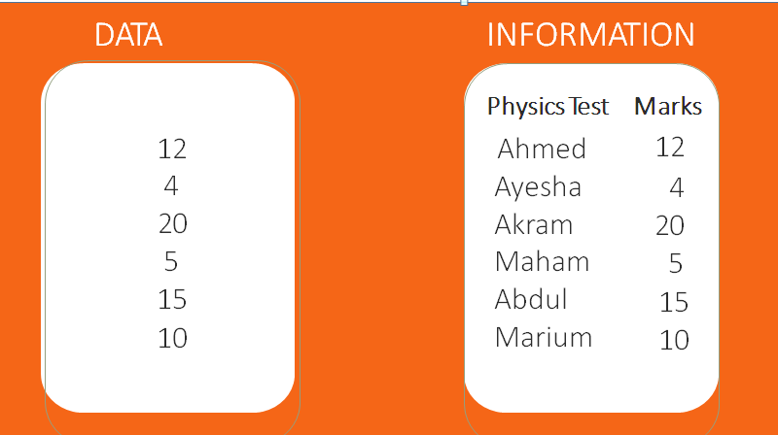
Example

Slide 10
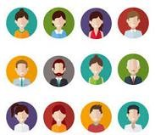
Users
Users are people who write computer programs or interact with the computer., Programmers, data entry operators, system analyst and computer hardware engineers.

Slide 11
Thank you

